Slide 1
Healthcare Medicare Quality Analysis
By Chelsea Kinzer

Slide 2
Introduction/Background
A hospital readmission is defined by The Centers of Medicaid and Medicare Services (CMS) as a patient admission to the hospital within 30 days of being discharged from an earlier hospital stay
In 2012, as a part of the Affordable Care Act (2010), the Hospital Readmissions Reductions Program (HRRP) was a Medicare value based program created to reduce excess admissions.
HRRP program focused on six 30-day standardized unplanned readmission:
Acute Myocardial Infarction (AMI)
Chronic Obstructive Pulmonary Disease (COPD)
Heart Failure (HF)
Pneumonia
Coronary Artery Bypass Graft (CABG) Surgery
Elective Primary Total Hip Arthroplasty and/or Total Knee Arthroplasty (THA/TKA)

Slide 3
Data Questions
How effective has the Healthcare Readmission Reduction Program (HRRP) been since implementation in 2012?
Does complications and deaths at a facility highly correlate with Readmissions?
What additional factors are contributing to the readmission of Medicare patients?

Slide 4
The Data
There was three data sets used during the analysis:
CMS Hospital Readmission and Reduction Program (HRRP): Provided Medicare data from 2014-2017 in regards to HRR.
CMS Complications and Death-State: Provided state-level data for the hip/knee complication measure, the CMS Patient Safety Indicators, and 30-day death rates.
Big Cities Health Coalition: Provided 18,000 data points across more than 50 health, socio-economic, and demographic indicators across 11 categories in the United States for health in 30 of the largest most urban cities.

Slide 5
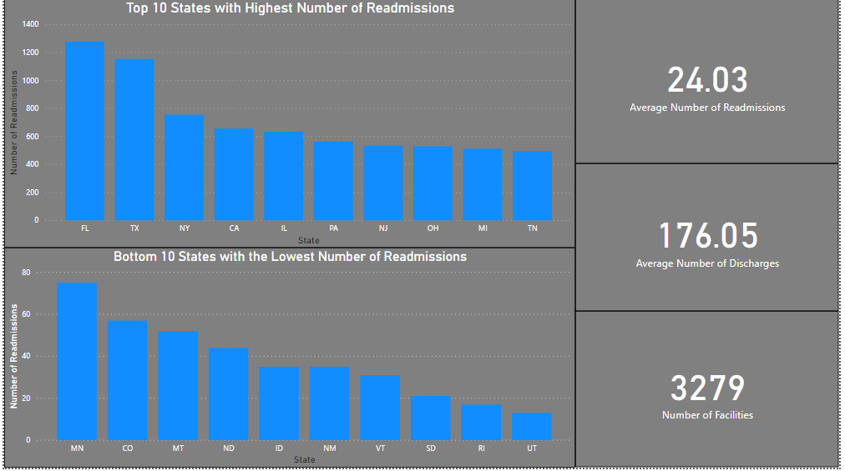
Top 10 States with highest and Lowest readmission Rates.

Slide 6
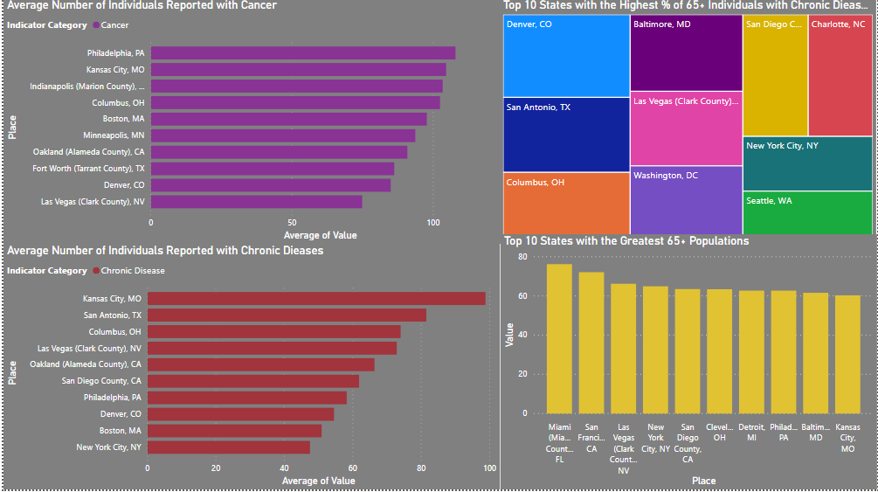
State Level Analysis

Slide 7
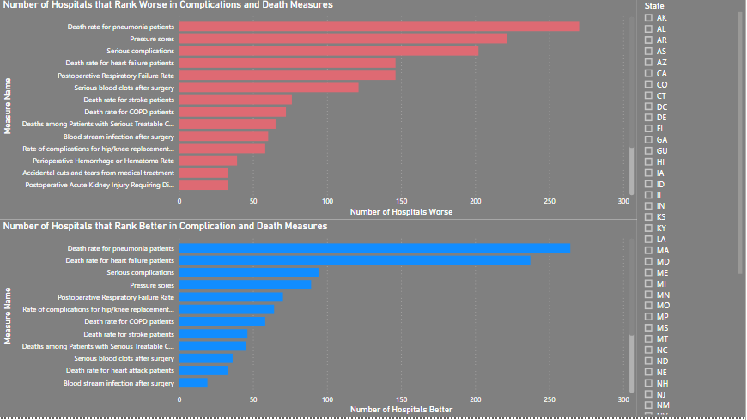
Complications and Death Analysis

Slide 8
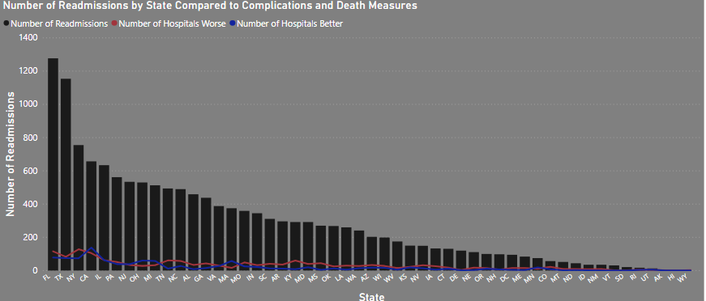
Readmissions compared to Complications and death

Slide 9
Conclusion
In conclusion, it does not seem as though the Hospital Readmission Program (HRRP) is making a huge impact.
Large metropolitan with larger geriatric populations seem to be struggling the most to prevent readmission rates.
Readmissions does not have a strong correlation with complications and death. More data may be needed to further explore.

Slide 10
Other Analysis Opportunities
Florida has the largest 65+ demographic as well as the highest amount of readmissions, it would be interesting to dig further with detail facility data to find out areas of opportunity.
It would be interesting to pull in Medicare payment data to highlight repeat excess readmission offenders.

Slide 11
References

